Slide 2
Unit 1
The PPC and trade
Unit 2
Price Indices – CPI and GDP Deflator
Tax brackets and inflation
Unit 3
Lump Sum Taxes
Depreciation
Income = Output
Government Spending vs Government expenditure
Policy vs Policy Action
Inflationary expectations
Rational Expectations Theory
Laffer Curve
Automatic Stabilizers
It is fiscal policy
Unit 4
Barter economy, double coincidence of wants
Investment sensitivity
Interest Rates are connected, how exactly?
Unit 5
Differences in time between tax, expenditure and money supply
Monetary rule ie. Monetarism
Keynesian vs Classical vs Monetarism
Unit 6
Net capital inflows (capital inflows – capital outflows)

Slide 3
Unit 1: Random Topics

Slide 4
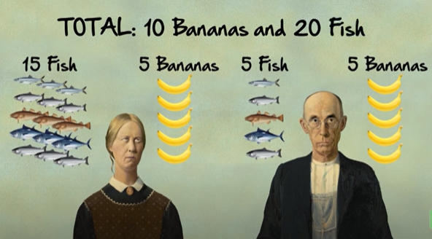
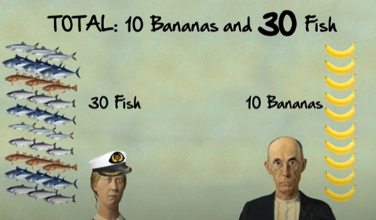
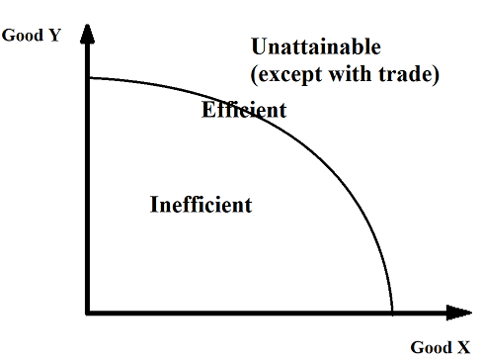

Gains From Trade
By specializing according to comparative advantage and then trading, both Bob and the woman can consume beyond their PPC at point D even though they can only produce on their PPC.
This is because, by specializing according to comparative advantage, the costs of production have fallen, which creates the same effect as if technology or resources had improved.
Note, there would be more factors at play to work out how exactly the total production would be divided between Anne and Frank but this is beyond the scope of the course.
Before Specializing
After Specializing
Summary
With trade, we can only produce on our PPC but we can consume outside of our PPC. This is the magic of trade!
Anne
Production = 10 Bananas, 0 Fish
Frank
Bananas
Bananas
Consumption = 20 Fish, 5 Bananas
Consumption = 10 Fish, 5 Bananas
(Consumption before trade = = Production = 15 Fish, 5 Bananas)
(Consumption before trade = Production = 5 Fish, 5 Bananas)
Production = 30 Fish, 0 Bananas
Fish
Fish

Slide 5
Does trade help us produce beyond our PPC?
No
Does trade help us consume beyond our PPC?
Yes

Slide 6
Unit 2: Random Topics

Slide 7
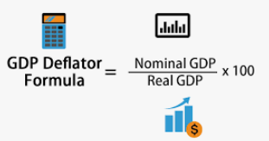
Price Indexes (also called Price Indices)
There are two main Price Indexes – CPI and the GDP Deflator
Both are:
Used to measure inflation
Have a value of 100 in the base year
Above 100 = inflation
100 = neither inflation or deflation
Below 100 = deflation
How to Answer Questions
When calculating inflation it doesn’t matter if it is the CPI or GDP deflator because both are just Price Indexes (PI) used to measure inflation.
Therefore the Inflation is equal to (PI_{new} – PI_{old}) / Pi_{old} x 100%
Questions involve the CPI when mentioning terms such as:
Market basket
Consumer basket
Questions involve the GDP deflator when mentioning terms such as:
Nominal and Real GDP
Questions that have goods and quantity, could sometimes technically be either CPI or GDP.
It could mean what is produced (GDP) by the market or what is consumed (CPI)

Slide 8
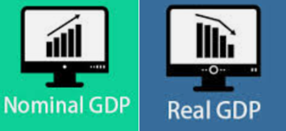
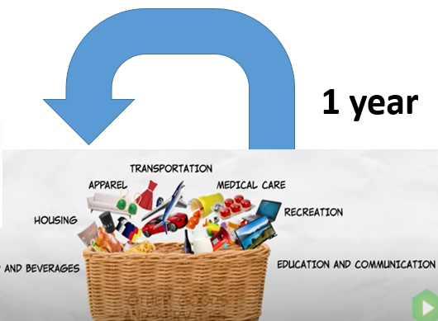
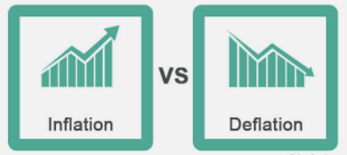

Price Indexes
Problems with the CPI
The CPI fails to take into consideration the changes in:
The quality of goods and services over time.
Eg. TVs, Cars, Computers are faster, more reliable and have more features compared to the past
The typical household market basket can change over time
New products – eg. Smartphones or even mobile phones didn’t exist 50 years ago and so it is hard to compare identical baskets
Tastes – eg. people start buying more leisure goods compared to past years which also changes the basket
Substituting goods for other goods. Eg. if the price of bread increases, people may buy more potatoes and so the price increase won’t affect consumers as much
Overstate inflation!
Consumer Price Index (CPI)
Takes a large basket of goods
Based on goods and services that consumers purchase
Measures imports (because the consumer basket will include imports (eg. iPhones, French wine, German Cars, American Movies)
The base year for the CPI is always 100
CPI = CPI Basket / CPI Basket_{base year} x 100
GDP Deflator
Compares nominal and real GDP
Based on goods and services produced in the economy
Doesn’t measure imports (only things produced as part of GDP)
The base year GDP deflator is also always 100.
Overstates or understates inflation!
Overstates or understates inflation!
Overstates inflation!
Price Index > 100
Inflation
Price level has increased
Price Index < 100
Deflation
Price level has decreased

Slide 9
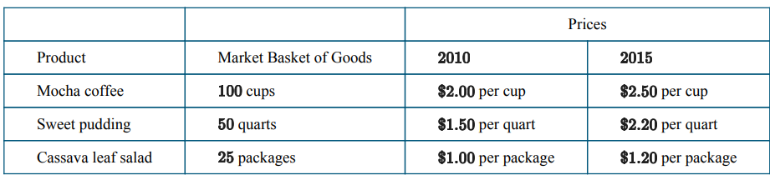
Is this question CPI or GDP Deflator?
Could be either because it doesn’t specify that the market basket is consumed by consumers.
Therefore we can use the MB_{new}/MB_{base} x 100 OR Nominal Output/Real Output x 100 to calculate the Price Index, PI
I personally would use the MB_{new}/MB_{base} x 100 method to calculate it, which kind of means it is CPI, but I would just refer to it as PI (Price Index).
Remember that both CPI and GDP deflator are just numbers around 100, ie. Price Indices, that show price level and can be used to calculate inflation.

Slide 10
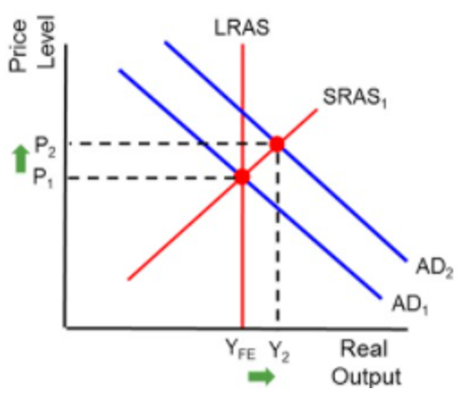
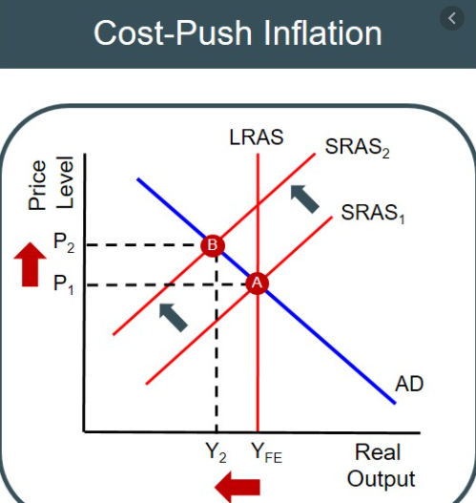
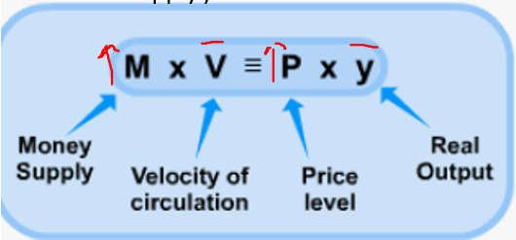
3 Causes of Inflation
To remember if it’s cost push, or cost pull inflation… remember that cost and push both have an ‘s’.
There are certain questions that will ask about ‘demand pull’ and ‘cost push’ inflation in particular. You should understand these causes of inflation.
Demand Pull Inflation
With an increase in AD caused by an increase in any of the components of AD (C+I+G+X-M), the equilibrium price level will be higher.
Eg. Prices in large cities are higher because people are more motivated to move there and will lead to higher AD.
Cost Push Inflation
A decrease in aggregate supply (Eg. Increased resource costs and supply costs)
This causes lower output and higher prices! This is also called stagflation = stagnation (no growth) + inflation
Eg.1970s US stagflation
In the 1970s the OPEC countries, for political reasons, reduced their oil supply to many countries including the United States. Because oil is such an important resource, it affected the supply of many businesses. This caused the SRAS (or arguably the LRAS) to shift to the left, causing an increase in the price level.
Quantity Theory of Money Inflation
According to some economists (Monetarism), the leading cause of inflation is always increases in the money supply.
This is effect is particularly apparent in poorly managed countries such as Zimbabwe and Venezuela where government money printing (creating new money) has lead to hyperinflation.
Inflation was so bad in Zimbabwe that the US dollar was temporarily adopted as the nation’s currency because its currency became worthless.

Slide 11
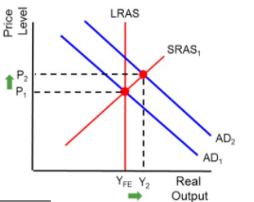
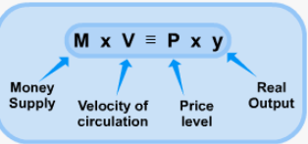
Causes of Inflation Review Question
What are three causes of inflation? Use graphs or equations to show the effect
Demand Pull, Cost Push, Increase in Money Supply

Slide 12
Expected Inflation vs Unexpected Inflation
Real Interest Rate = Nominal Interest Rate - Inflation
Actual Inflation = Expected Inflation + Unexpected Inflation
Also referred to as anticipated and unanticipated inflation.
Expected/anticipated inflation
Inflation that people expect to occur in the future.
When inflation is expected to increase in the future, banks will increase the nominal interest rate to make sure they receive enough real interest when they lend money.
Eg. The bank wants 2% real interest. They know inflation will be 5% in the future so they set a nominal interest rate of 5+2=7% (NIR=RIR+Infl) therefore ensuring 2% real interest.
Expected/
Anticipated Inflation
Unexpected/
Unanticipated Inflation
Will change the nominal interest rates because banks will increase the nominal interest rate.
Therefore Real Interest Rate will NOT change.
Neither borrowers or lenders gain.
Will NOT change the nominal interest rates because banks won’t be able to adjust.
Therefore Real Interest Rate will change.
Borrowers gain, lenders lose.
Unexpected inflation
Inflation that people did not expect to happen. In this case, banks will be surprised by the inflation.
Therefore, they won’t set the nominal interest rate high enough.
Eg. The bank wants 2% real interest. They expect inflation will be 5% in the future so they set a nominal interest rate of 5+2=7% (NIR=RIR+Infl) However, there is extra unepected inflation of 2%. Therefore the real interest = NIR – Infl = 7-7% = 0%
Summary
Expected Inflation: Banks WILL be able to predict and they will put up the nominal interest rate. Therefore RIR is constant.
Unexpected Inflation: Banks WILL NOT be able to predict and they won’t have put up their nominal interest rate. Therefore RIR will change and Banks will lose and borrowers will gain.

Slide 13
Expected Vs Unexpected Inflation Example
Real Interest Rate = Nominal Interest Rate - Inflation
Actual Inflation = Expected Inflation + Unexpected Inflation
Expected Inflation:
Banks want 2% Real Interest on their loans.
They expect 5% Inflation and 5% inflation occurs.
They will set nominal interest rate of 7%. (NIR = RIR + Inflation)
Unexpected Inflation:
Banks want 2% Real Interest on their loans.
They expect 5% Inflation and 7% inflation occurs. Ie. 5% expected inflation, 2% unexpected inflation.
The banks had set an interest rate of 7%. (NIR = RIR + Expected Inflation)
However, because of the expected inflation, RIR = NIR – Inflation = 7% - 5% (expected) – 2% (unexpected) = 0% inflation.
So the RIR is 0% when the banks had planned for 2%.
Therefore, borrowers gain and lenders lose.

Slide 14
A bank wants 1% real interest on its loans. If the inflation is 3% today and there is 5% expected inflation in the future, will the nominal interest rate change? Will the real interest rate change?
Yes, the banks will predict the inflation and increase the nominal interest rate from 4% to 6%. The RIR will not change, remaining at 1%.
A bank wants 1% real interest on its loans. If the inflation is 3% today and but then unexpectedly the inflation rate rises to 5%, will the nominal interest rate change? Will the real interest rate change?
No, because the bank did not expect the extra 2% unexpected inflation and were not able to adjust the nominal interest rate. (Unless the interest rate is variable). Therefore the real interest rate will decrease to -1% (RIR = NIR – Inflation = 4 – 5 = -1). The bank will lose and the borrower will gain.

Slide 15
Expected Vs Unexpected Inflation Summary
 | Nominal Interest Rate | Real Interest Rate | Winners/Losers
Expected/Anticipated Inflation | Changes - banks will expect the inflation and increase the NIR accordingly | Same - Because RIR = NIR – Inflation, and banks increase NIR to cancel out the inflation | No winners / losers
Unexpected/Unanticipated Inflation | Same -banks are ‘caught by surprise’ and can’t change the NIR (Note: we assume we are talking about fixed interest rates.) | Decreases - Because RIR = NIR – Inflation, and NIR is the same, so RIR dereases. | Lenders and savers lose (they are paid back with less valuable money) Borrowers gain (Note: if unexpected inflation is negative ie. Deflation, the borrowers lose and lenders gain)
Real Interest Rate = Nominal Interest Rate – Inflation
Actual Inflation = Expected Inflation + Unexpected Inflation

Slide 16
Expected Vs Unexpected Inflation Summary
 | Nominal Interest Rate | Real Interest Rate | Winners/Losers
Expected/Anticipated Inflation | Changes - banks will expect the inflation and increase the NIR accordingly | Same - Because RIR = NIR – Inflation, and banks increase NIR to cancel out the inflation | No winners / losers
Unexpected/Unanticipated Inflation | Same -banks are ‘caught by surprise’ and can’t change the NIR (Note: we assume we are talking about fixed interest rates.) | Decreases - Because RIR = NIR – Inflation, and NIR is the same, so RIR dereases. | Lenders and savers lose (they are paid back with less valuable money) Borrowers gain (Note: if unexpected inflation is negative ie. Deflation, the borrowers lose and lenders gain)
Real Interest Rate = Nominal Interest Rate – Inflation
Actual Inflation = Expected Inflation + Unexpected Inflation

Slide 17
A lender will realize unexpected benefit when the
(A) actual inflation rate is higher than the anticipated inflation rate
(B) actual inflation rate is lower than the anticipated inflation rate
(C) rate of interest is greater than the actual rate of inflation
(D) rate of interest is less than the actual rate of inflation
(E) rate of interest equals the actual rate of inflation
Answer:
Actual Inflation = Expected Inflation + Unexpected Inflation
Lender gains when there is negative unexpected inflation (ie. Unexpected deflation). When Actual Inflation < expected inflation, therefore unexpected inflation is negative. Therefore B

Slide 18
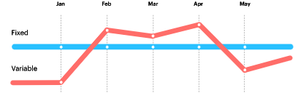
Fixed vs Variable Interest Rates
Summary
Fixed interest rate – NIR doesn't change if inflation goes up. Therefore borrowers gain with higher inflation. Most questions are about fixed interest rates.
Variable Interest Rate – NIR will change if inflation goes up. Therefore borrowers/lenders won’t win or lose with higher inflation.
When someone borrows money from a bank, the contract could have either a fixed or variable interest rate.
Fixed = doesn’t change
Variable = does change
Fixed means that even if inflation goes up for example, the nominal interest rate will not change.
Therefore if there is unexpected inflation, borrowers will gain and lenders (banks) will lose.
Variable can mean many things, but in our course it typically means it will change with inflation. Therefore if inflation goes up, the nominal interest rate will also go up.
Therefore there won’t be any winners or losers from inflation.
However almost all questions in AP Macro will concern fixed interest rates. In the real world, variable interest rates are very common and they will vary based on different factors.

Slide 19
If there is 2% unexpected inflation, with a FIXED interest rate, who wins and who losers in terms of borrowers and lenders?
Borrowers will gain, because the banks weren’t able to increase the nominal interest rate high enough. Therefore the real interest will be lower. (RIR = NIR – Inflation)
If there is 2% unexpected inflation, with a VARIABLE interest rate, who wins and who losers in terms of borrowers and lenders?
Noone will gain/lose because the nominal interest rate will adjust so that the real interest rate will remain the same.

Slide 20
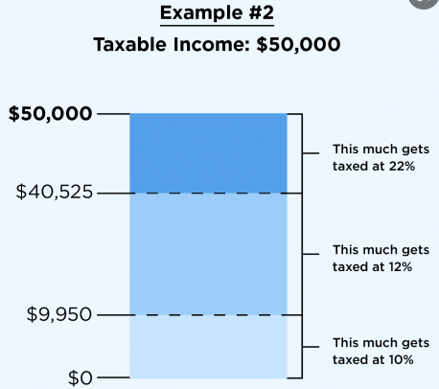
Taxes, Tax brackets and Inflation
Summary
Inflation pushes people into higher tax brackets which increases their tax burden (in a progressive tax system).
We had briefly covered the three types of tax systems: regressive, proportional, progressive.
The US system, and many others have a progressive system where people earning more income pay a higher percentage of tax.
These are often referred to as ‘tax brackets’. Ie. If you go from earing $50,000 to $100,000 you may have gone from the 30% tax bracket to the 35% tax bracket.
When we have inflation, people end up in higher tax brackets. However this can be a problem if people’s nominal income has gone up but their real income has not. In this case, their real tax has actually increased because they are paying a higher tax percentage!
Therefore, inflation can impose a higher tax burden on people and so they are ‘losers’ from inflation (in addition to other costs of inflation).
If nominal wages go up, more people will move into a higher bracket, causing a higher percentage of tax to be paid.

Slide 21
When you earn more, what often happens to the percentage of tax that you pay? What does this have to do with tax brackets.
You generally pay a higher percentage of tax (progressive tax system), meaning you are in a higher tax bracket.

Slide 22
Unit 3: Random Topics

Slide 23
Lump Sum Taxes
Lump sum taxes are taxes that everyone must pay the same amount.
Eg. Every single person must pay $1000 tax.
A millionaire will pay $1000.
A poor person will also pay $1000.
A person who buys a lot of goods and services pays $1000.
A retired person pays $1000.
Everyone pays $1000.
This type of tax almost never occurs in the real world.
Usually wealthy people pay higher tax.
People also pay tax when they buy things, and so those who buy more pay higher taxes.
The purpose of the lump sum tax is often to simplify a question. It is a way of saying, don’t worry about the effects of tax on this question, and just focus on the other part of the question!

Slide 24
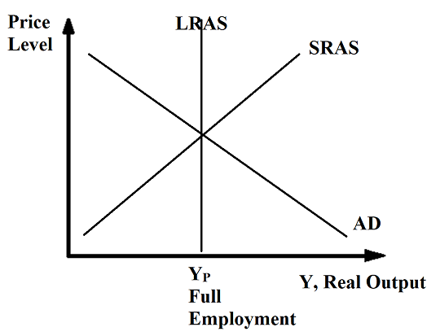
Income = Output = Expenditure
Summary
Income is the same as output, therefore both can be represented on the X axis of the AD/AS graph.
There are three methods of calculating GDP.
Expenditure Method = C+I+G+(X-M)
Income Method (All wages, rent, interest, profits)
Value Added Method
Because the income method is equal to the expenditure method, therefore what we produce is equal to what we earn.
When we produce something we sell it! Therefore everything produced creates income.
Real Income
Real GDP

Slide 25
If real total production in the economy in one year is equal to $5 billion, what is the real income?
Also $5 Billion, because real output = RGDP = real income.

Slide 26
Government Spending vs Government Expenditures
Government Expenditure
Government expenditures = All government spending of money
Government spending (G) = Government spending money on goods and services produced in that year, therefore it IS counted in GDP
Government transfers = ‘taking money from the rich and to the poor’ through taxing wealthier people and paying it out through unemployment benefits, disability allowance, retirement payments etc. Because there are no goods and services being produced, it is not counted in GDP.
Government Spending (G)
Government transfers
Government Expenditure = Government Spending + Government Transfer Payments

Slide 27
What is the difference between government expenditure and government spending?
Government spending is only spending on goods and services produced in that year and is therefore counted in GDP.
Government expenditure also includes government transfers (which are not included in GDP)
Gov Exp = Gov spending + gov transfers

Slide 28

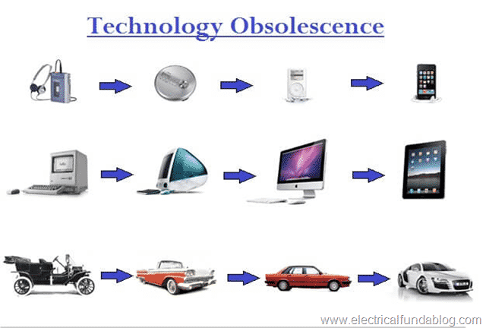
Depreciation
Depreciation is the term given to the decrease in value of things. (We saw this in Unit 6 when studying exchange rates but it takes on another meaning.)
In economics, when we refer to ‘depreciation’ we are typically referring to the decrease in value of equipment and machinery.
Eg. A delivery truck is bought in 2015. After 7 years of use, it no longer drives as well as it used to and so you cannot do as many deliveries. The value of the truck has therefore decreased.
This can also be called by obsolescence, when new technologies emerge to make the equipment not as valuable.
Therefore depreciation can be seen to decrease the value of the capital.
This will cause a decrease in the LRAS, because there is now less capital per worker.
Therefore with depreciation, investment is needed to repair/fix the worn out capital.
Above: Loss of value though ‘wear and tear’ and exposure to weather etc.
Summary
Depreciation = loss of value of capital stock. This will affect the LRAS.

Slide 29
What is depreciation? What effect does it have on the stock of capital goods in the economy?
Depreciation is a decrease in the value of things, often through use/wear and tear.
It causes a decrease in the value of capital goods in the economy.
If there is depreciation of $1 million dollars, and only 700K of investment in 1 year, what happens to the amount of capital stock (amount of capital goods)?
The total value of capital stock decreases by 300K.

Slide 30
Automatic Stabilizers
Fiscal Policy
Automatic Stabilizers = a type of fiscal policy
It involves government transfers and tax, which are ‘automatically’ set.
Eg. The government has a policy of taxing everyone 30% of their income and giving people who earn less than $20,000 a year $2000.
If this policy is unchanged then:
In a Recessionary Gap:
Government Transfers increase: More people earn less than $20,000 in a year and so the government has to pay out more government transfers.
Tax Decreases: Incomes fall and so governments receive 30% of a smaller amount of income which means less tax revenue.
In an Inflationary Gap
Government Transfers decrease: Fewer people earn less than $20,000 in a year and so the government doesn’t need to pay out as much.
Tax Decreases: Incomes rise and so 30% of a larger number = more tax.
Automatic Stabilizers
(Non-discretionary Fiscal Policy)
Government transfer policy
Tax rate
Discretionary Fiscal Policy
Government policies where human decisions are made.
Eg. Build hospitals, schools, roads.
Both are help to stabilize the business cycle.

Slide 31
When the economy enters a recession and there is no DISCRETIONARY fiscal policy, what occurs to help stabilize the economy?
Automatic stabilizers will automatically increase gov transfers and reduce tax.
This will help push AD back to the right and reduce the size of the output gap.

Slide 32
Automatic Stabilizers vs Macroeconomic Self Adjustment
≠
Macroeconomic Self Adjustment
Automatic Stabilizers
= Fiscal Policy
Tax
Government Transfers
= what would happen even if there was no government at all!
Wages adjust in the long run
SRAS adjusts in the long run
Shifts AD
Shifts SRAS

Slide 33
What is the term used for the adjustment of the economy without any government intervention? What happens in the AD/AS graph?
Macroeconomic self adjustment.
The SRAS shifts
What is the term used for no discretionary fiscal policy that occurs automatically? What happens in the AD/AS graph?
Automatic Stabilizers.
The AD shifts.

Slide 34
Policy vs Policy Action
Summary
In the AP exam, when they ask for a policy action, make sure to talk about the specific action as shown in the table below.
The policy means fiscal policy or monetary policy and whether it’s expansionary or contractionary.
The action means the specific thing that is done.
The following table shows the actions of FP and MP.
In the Free Response questions, be sure to give a specific policy action when asked!
Policy Type | Policy Action
Expansionary FP | ↑Government Expenditure ↓Tax
Contractionary FP | ↑Tax ↓Government Expenditure
Expansionary MP | Buy bonds ↓Reserve requirement ↓Discount Rate/Federal Funds Rate
Contractionary MP | Sell bonds ↑Reserve requirement ↑Discount Rate/Federal Funds Rate

Slide 35
Give a policy action if the government wishes to fight high unemployment in a recession using fiscal policy.
Lower taxes
Give a policy action if the government wishes to correct high inflation using monetary policy.
Sell bonds

Slide 36
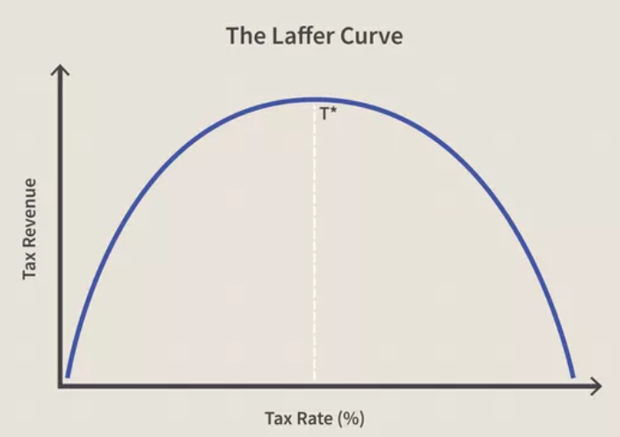
The Laffer Curve
The Laffer curve, named after economist Arthur Laffer shows how much tax revenue a government can raise depending on the tax rate.
0% tax rate:
The tax revenue will obviously be zero.
100% tax rate:
People will not want to work and therefore have little to no income to pay tax with.
In between tax rate:
There is an optimal level where people are paying tax but still have an incentive to work, therefore creating the highest tax revenue.
Note: We could apply this concept to many different scenarios. Eg. Study and academic performance. If you study 0 hours you won’t know the content. If you study 24 hours you will be so exhausted you can’t perform.

Slide 37
Why doesn’t charging the maximum amount of tax create the most tax revenue?
It discourages people from working, and so incomes won’t be as high. This means there is less income to tax.

Slide 38
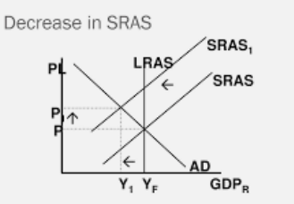
Inflationary Expectations
Inflationary Expectations
(expectation that the prices will go up)
Some questions include the expression: Inflationary Expectations
When people expect higher inflation, they will change their behavior.
This includes workers who will ask for higher wages.
This decreases the SRAS because firms because their costs have increased.
Summary
↑Inflationary Expectations→Workers ask for higher wages→↑Firm costs→↓SRAS

Slide 39
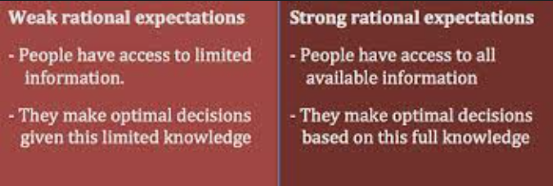
Rational Expectations Theory
Summary
Rational Expectations = people use past and current information to change their behavior. This can apply in many situations, including inflationary expectations.
Rational expectations theory is the idea that people within an economy have an understanding of how the economy works, and that people will change their behavior in a logical way when they learn new information about the economy.
Examples:
If people see rising inflation over a period of time they will predict that the future will also have high inflation, and will adjust their behavior, probably by asking for higher prices.
When people see the government increasing the money supply, they know the price level will eventually go up and so they increase the price of goods and services and ask for higher wages
If this theory is true then we would see a reduction in the effectiveness of the policies
The real world answer is likely that many people do change their behavior rationally, however many people likely do not.

Slide 40
According to rational expectations theory, what will happen to wages, if there is an increase in inflationary expectations.
People will anticipate inflation and ask for higher wages, therefore pushing up wages.

Slide 41
Effect of Inflation on X-M
Summary
↑Inflation →↓Net Exports because the 1st effect is stronger than the effect caused by a change in the exchange rate.
In unit 6 we looked at how inflation will affect the exchange rate.
↑Inflation →↓Demand for currency ↑Supply of currency →↓Exchange Rate →↑Net Exports
However, this would be a secondary effect.
The first effect is that inflation will directly affect the demand for Imports and Exports. (Recall the 3 reasons for the slope of the AD, Net Export Effect)
↑Inflation →↓Exports, ↑Imports →↓Net Exports
So in any question that talks about inflation and its effect on exports, remember that more inflation causes less exports.
Net Exports
Net Exports

Slide 42
Unit 4: Random Topics

Slide 43
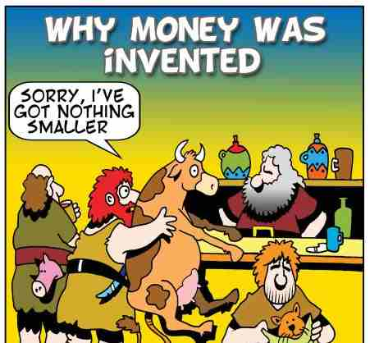
Barter and Barter Economies
Summary
Barter = trading goods and services
Double coincidence of wants = Person A is happy to trade with Person B
Money solves the problem when there is no double coincidence of wants.
Definition of Money
Anything that can be used as a medium of exchange.
Barter
Without money we would be forced to barter for goods and services.
Barter is where two parties trade goods/services.
Eg. I want some apples so I trade you for some rice.
Double Coincidence of Wants
However, barter requires Person A to want what Person B has. This is called a double coincidence of wants.
However, this creates problems when Person A doesn’t want what Person B has, ie. there isn’t a double coincidence of wants.
In this situation, Person B has to trade with a Person C, to get the thing that Person A wants. This takes extra time and effort which is inefficient.
Money eliminates this problem because everyone accepts money.
Certain things can be used as payment such as gift cards but are not universally accepted and so are called ‘near monies’.

Slide 44
Suppose you are living in a barter economy. You want to trade Mr David some of your apples for economic lessons. However Mr David dislikes apples, but loves watermelons. What must you do instead?
You must trade your apples for watermelons with another person and then return to offer Mr David the watermelons.
How can money solve make this process more straightforward?
With money, you can simply pay for the economics lessons directly which Mr David will accept because money can be used in all transactions.

Slide 45
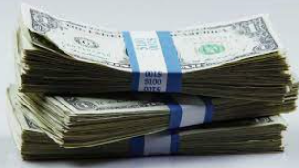

Two Meanings of Capital
Summary
Capital = equipment and machines
Capital = money
Somewhat confusingly, capital can take on slightly different meanings depending on the context, similar to many words in English (eg. Lunch break vs break computer, Wrist watch vs watch TV etc.)
Capital = Equipment and Machines
If you see the terms:
Capital stock
Capital formation
Capital goods
Investment in capital
This refers to equipment and machines which firms use to help produce goods.
Capital = money
If you see the terms:
Capital inflows/outflows
Foreign capital
This refers to money which is lent to businesses and used by businesses.

Slide 46


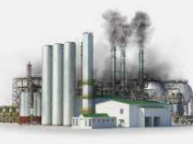
Meaning of Investment
Summary
Investment = spending by firms
Investment = people growing their money including capital flow movements
Investment can also have some slightly different meanings.
Investment = money spent by firms to expand their business
This is counted in GDP because it is purchase of goods and services in the current year (GDP/AD = C+I+G+(X-M))
Eg. A firm builds a factory or hires new workers.
Investment = money that investors (including foreign investors) use to earn more money
Eg. A foreign investor moves money into a bank in your country can be referred to as investment, (but does not contribute to GDP in this case because financial assets are not counted in GDP) ie. Capital inflows
Note: If the investment takes on this meaning, then there will be other clues that it is a capital inflows question

Slide 47
Are foreign capital inflows counted in GDP? Why not?
Foreign capital inflows, though often called investment, are not the same as firms spending on machinery, equipment, technology, worker training etc. which would be counted in GDP if they are goods/services produced in that year (Investment (as part of AD = C+I+G+(X-M)).

Slide 48
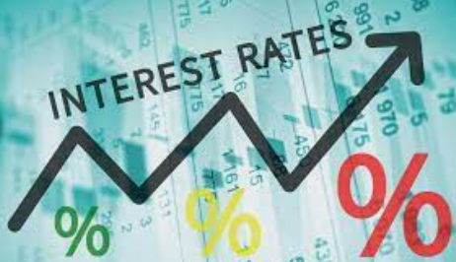
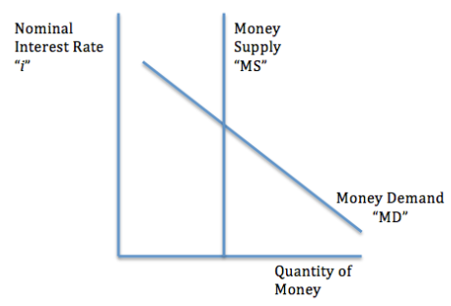
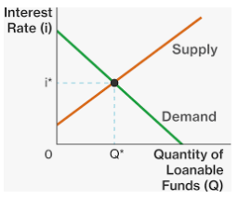
Interest Rates are connected
While we have distinguished between the nominal interest rate in the money market, and the real interest rate in the loanable funds market, the two will generally move up and down together (except in the case of inflation where only the real interest will be affected).
So if there is a change in the nominal interest rate in the money market we can also assume there is a change in the market for loanable funds.
Question examples:
You will notice in some of these questions, even if the IR has increased in the loanable funds market, that the government can reduce the interest rate by increasing money supply in the money market.
Also called liquidity preference model (because it shows how much people demand liquid money)
Summary
Whether in the Money Market or Loanable funds market, we can often treat the interest rate in both as one interest rate.

Slide 49
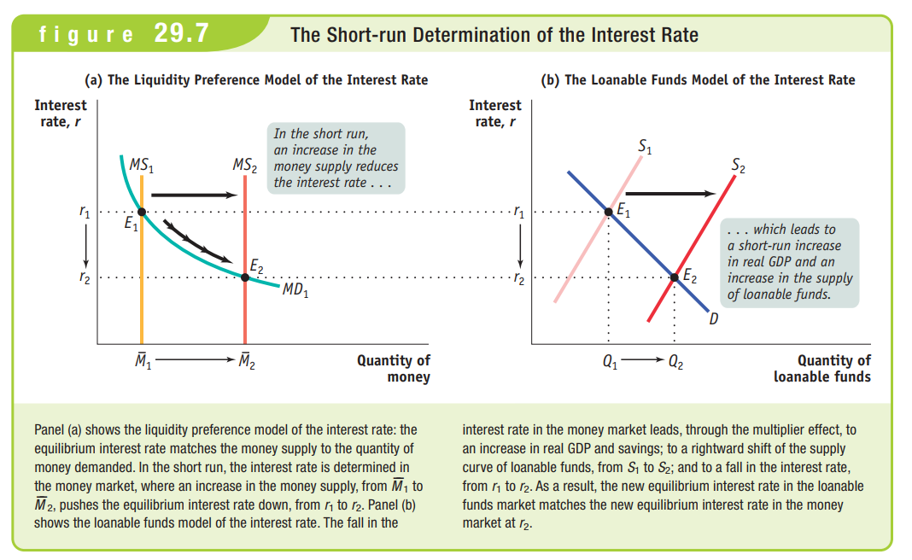

Slide 50
What causes RIR in the loanale funds market to decrease when there is a decrease in the interest rate in the money market caused by increased MS?
The lower interest rate leads to more spending in the economy, which, due to the spending multiplier, leads to higher incomes. With higher incomes people have more money to save, therefore increasing the supply of loanable funds.

Slide 51
Unit 5: Random Topics

Slide 52
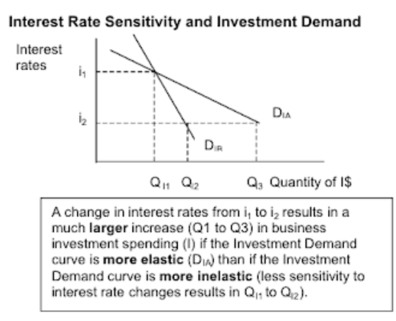
Investment Sensitivity
Investment sensitivity refers to how much investment changes when interest rates change.
Example:
Firm A desperately needs a new machine and even though the interest rate is high, will have to borrow money to buy the machine.
Firm B could buy a new machine or they could wait a few years. The interest rate is high and they decide to wait until the interest rate drops.
Which one of these has the higher investment sensitivity?
Answer: Firm B, because the interest rate affects their decision, whereas firm A ‘doesn’t care’ about the interest rate and will invest regardless.
Graphically, a more sensitive Investment curve is ‘flatter’ and a less sensitive Investment curve is ‘steeper’.
Note: In microeconomics this is referred to as elastic (flatter) and inelastic (steeper).
Summary
Investment Sensitivity to Interest Rates:
High sensitivity = ↑Interest Rates→ ↓investment by a lot
Low sensitivity = ↑Interest Rates→ ↓investment only a little

Slide 53
Suppose there are two investment curves, one is more vertical and the other more horizontal. Which one has greater sensitivity to interest rate changes?
The horizontal curve shows greater sensitivity to interest rates because there will be a greater change when interest rates change.

Slide 54
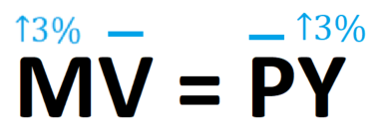
Monetary Rule
Note: In the vast majority of questions, you can continue to assume that V and Y are stable.
The main idea of the monetary rule is based on a ‘school of thought’ in economics called Monetarism which favors the use of Monetary Policy to stabilize the economy.
We should recall the quantity theory of money, MV = PY.
We before stated that we assume V and Y to be stable. However Y DOES increase over time through technology increases etc.
In order to keep price stable the money supply should increase at the same rate as Real GDP growth.
In this case, if there is a 3% increase in Y (RGDP) then if the government wants to keep price levels stable, they should increase money supply by 3%.
Note: We are still assuming that money velocity, V is somewhat constant.
Summary
Monetary Rule = keeping price level constant by increasing money supply at the same speed as RGDP growth (Y growth)

Slide 55
If the RGDP increases at an average rate of 5% per year, what should the central bank do to maintain the price level in the economy.
The central bank can increase money supply to match the change in RGDP, ie. Increase by 5%.

Slide 56

Tax Credits
What is a tax credit? It is a way of reducing tax that typically businesses but also individuals must pay.
A tax credit is a direct decrease to the amount of tax that is owed
Eg. If a business receives tax credits for every dollar it spends training its workers, then it can use those credits to pay less income tax.
Eg. Profit = 1 million. Money spent on training workers = 50K. Income tax = 20%.
No tax credits: Tax = 1 million x 0.2 = 200K
After tax credits: Tax = 1 million x 0.2 – worker training tax credit = 150K
Therefore an increase in tax credits means a decrease in tax.
Summary
Tax credit = subtract from the tax
Increase tax credit = pay less tax

Slide 57
The government increases tax credits for new businesses. What happens to the tax that these new businesses will have to pay?
They will decrease. Tax credit = pay less tax.

Slide 58
Comparing Economic Schools of Thought
While we have so far presented economics as containing absolute truths similar to a hard science, the reality is that economic theories are exactly that; theories, and so there is quite a lot of disagreement over many issues.
Several economic schools of thought emerged in the 20th century which are still relevant today.

Slide 59
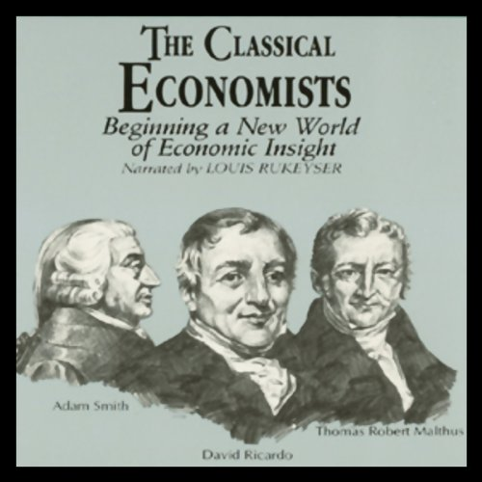
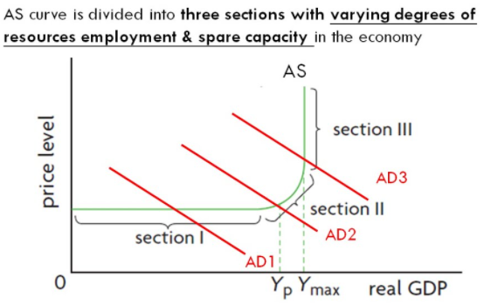
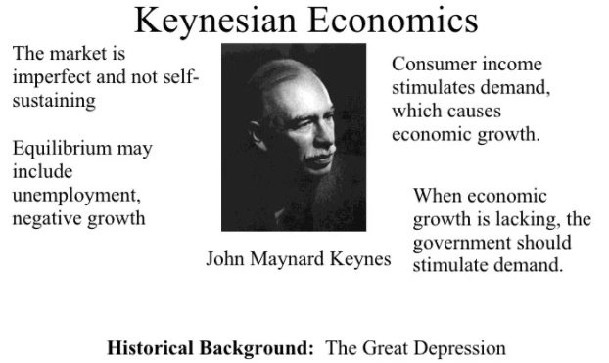
Classical Economics vs Keynesian Economics
Classical/Neoclassical Economics
The economy is self adjusting and doesn’t require economic management.
Say’s Law
‘If you produce it, they will buy it.’
Aggregate Supply determines Aggregate Demand
Keynesian Economics
The economy takes too long to self adjust and therefore government intervention is needed
Expansionary Fiscal Policy and Budget Deficits can be used to get an economy out of a recession
Ideally, in positive output gap times, the government can pay back the budget deficit with more contractionary FP
Keynesian AS curve supports the use of FP when an economy is in the ‘spare capacity’/flat part of the curve.

Slide 60
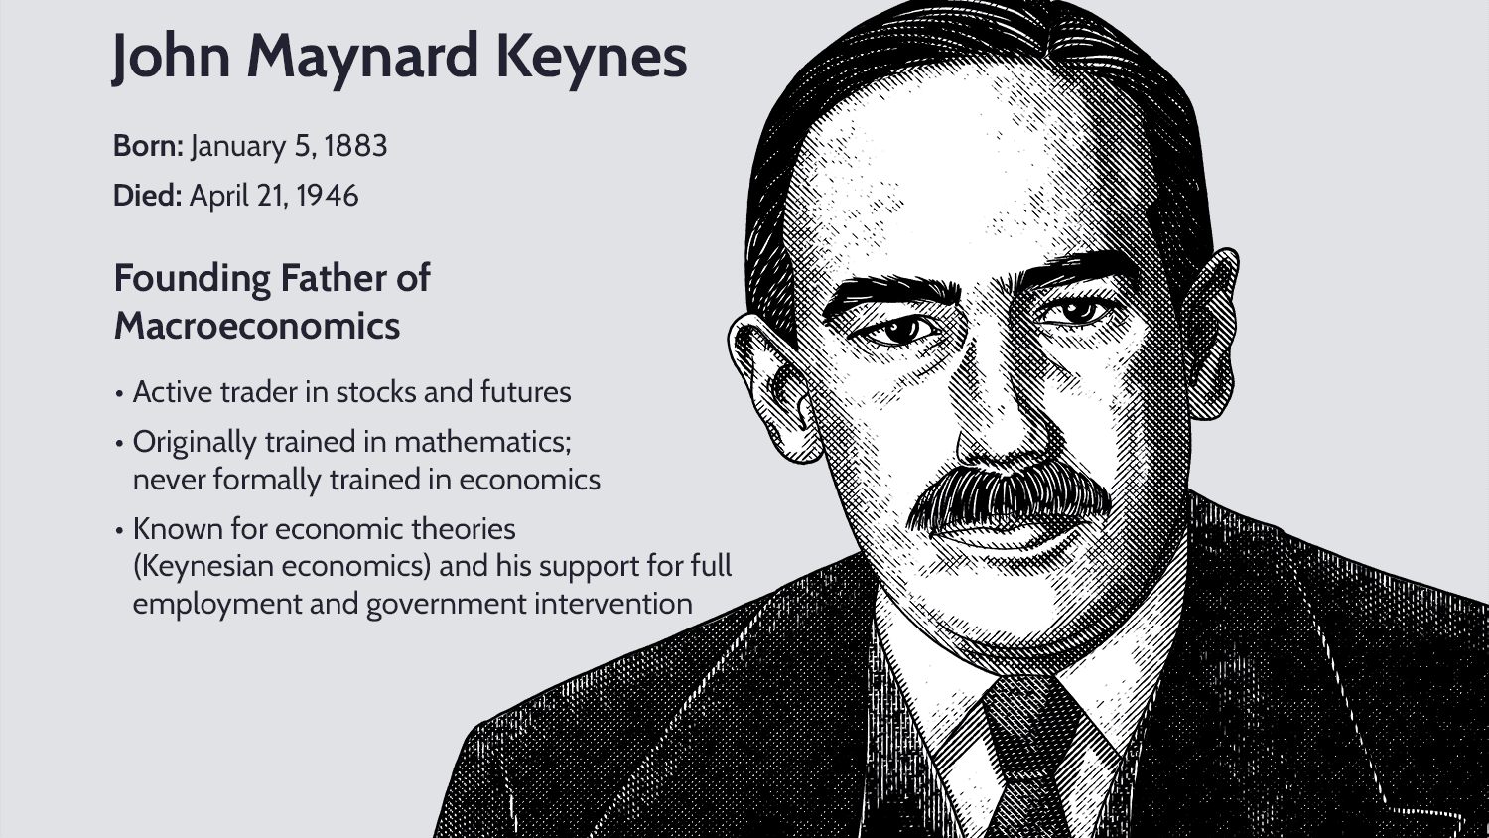
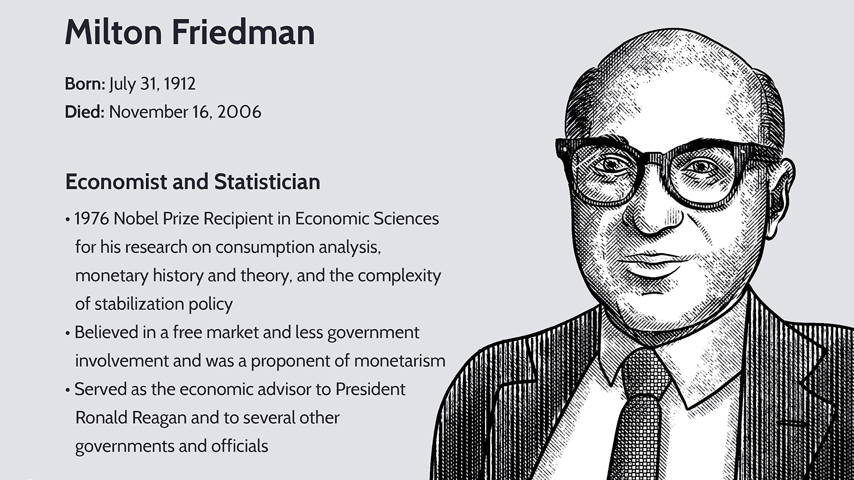
Keynesian Economics vs Monetarism
Keynesian Economics
Began in the 1930s
‘founder’ is John Maynard Keynes
Both believe in sticky wages which can lead to output gaps in the short run
Believe in the use of fiscal policy to close output gaps
Consider monetary policy to be weak because of ‘liquidity traps’
Monetarism
Began in the 1960s
‘founder’ is Milton Friedman
Both believe in sticky wages which can lead to output gaps in the short run
Believe in the use of monetary policy to close output gaps
Consider fiscal policy to be limited because of crowding out and lags
Quantity Theory of Money
MV = PY
Recommend a monetary rule where money supply should be increased at the same rate as Real GDP growth to keep the price level stable

Slide 61
What is a key difference between Classical Economics and Keynesian economics?
Keynesian economics favors use of government policy (Fiscal Policy) to get economies out of recessions where as Classical Economics believes the most efficient thing is for the economy to correct itself.
What is a key difference between Keynesian Economics and Monetarism?
Keynesian Economics focuses on the use of Fiscal Policy and Monetarism focuses on the use of Monetary Policy.
Who are the founders of these two schools of thought?
Keynesian – John Maynard Keynes
Monetarism – Milton Friedman

Slide 62
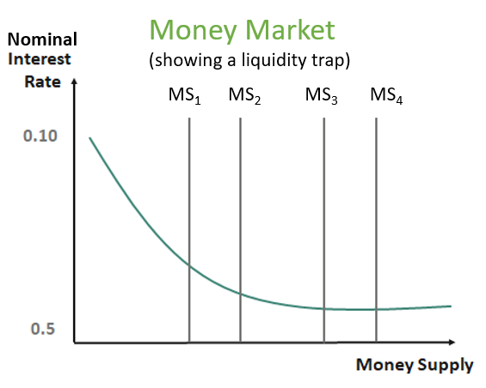
Liquidity Trap
Summary
Keynesian thinking believes that monetary policy loses effectiveness when the interest rate won’t decrease any more. (This is because below a certain IR, people will keep all of their money as liquid money).
Keynesian economists tended to believe that monetary policy would be subject to a ‘liquidity trap’ which causes monetary policy to reach a point where it is no longer effective.
The reason for this liquidity trap is that once interest rates get low enough, people will keep all their money as cash. Therefore, the interest rate can’t go any lower.
Eg. Once the interest rate is 0.5%, many people may keep all their money as cash because the opportunity cost of doing so is so low. So if the central bank increases the money supply more, the interest rate will not fall and the economy will be unchanged.
Visually this appears as the MD curve becoming flatter once the interest rate reaches a certain level.
This shows that once the interest rate reaches a certain level, it can’t fall any further because the cost of holding money is small enough that people won’t care.
Increasing MS₁ to MS₂ lowers the interest rate, but MS₃ to MS₄ has no effect on lowering the interest rate.

Slide 63
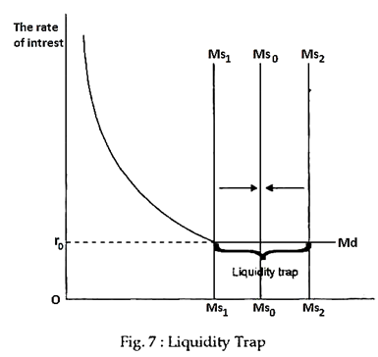

Slide 64
What happens when the interest rate reaches a certain point, what happens to people’s decision making with liquid money.
Once the interest rate is low enough, people are already holding all their money as liquid money, therefore the interest rate can’t go any lower.
Therefore, expansionary MP stops being effective after this point.
What consequence does this have for the effectiveness of monetary policy?
At a certain point, monetary policy will no longer be effective.

Slide 65

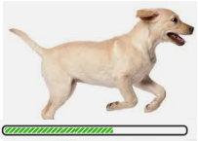

Speed of Implementing Various Policies
Slowest
Discretionary Fiscal Policy
Data lags (eg. Collecting employment statistics to assess if the UR has increased)
Political Lags (eg. Passing the proposal to build a road)
Implementation lags (eg. Planning to build a road)
Monetary Policy
Data lags (eg. Collecting employment statistics to assess if the UR has increased)
Automatic Stabilizers (Non-discretionary fiscal policy)
Faster
Fastest

Slide 66
Which kind of government intervention is typically slowest? Why?
Discretionary fiscal policy.
It has many lags including political lags, data lags and implementation lags.

Slide 67
Unit 6: Random Topics

Slide 68

Net Capital Inflows
Just like we refer to net exports, which is made up of movements in two directions, exports (money in) and imports (money out), we can refer to net capital inflows
Remember that capital inflows in this case refers to financial capital inflows, where foreign investors move money into bank accounts or buy bonds, thereby lending money for local borrowers.
Net financial capital inflows = financial capital inflows – financial capital outflows
Note: With regards to the foreign exchange market:
Financial capital inflows = D_{currency}
Financial capital outflows = S_{currency}

Slide 69
Suppose you have in increase in capital inflows of 5 million and an increase in capital outflows of 8 million, what happens to net capital inflows?
Net capital inflows = capital inflows - capital outflows = 5 – 8 = -3 million
Ie. Overall, 3 million of capital has flowed out of the country.
What happens to demand and supply for the currency of that country?
Demand changes (capital inflows) and supply changes (capital outflows) by a larger amount.

